Slide 1
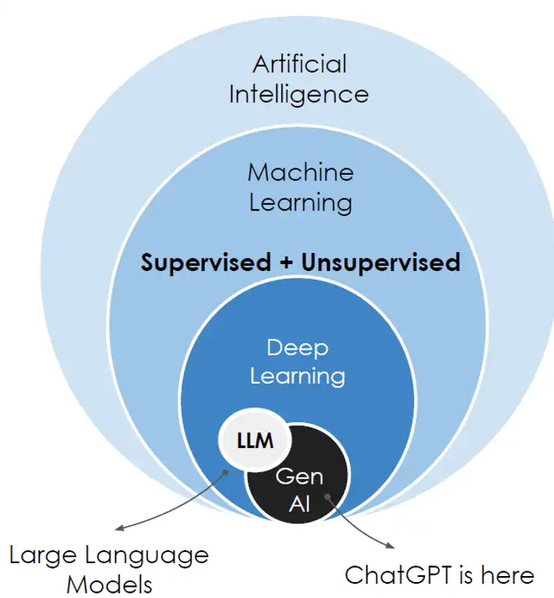
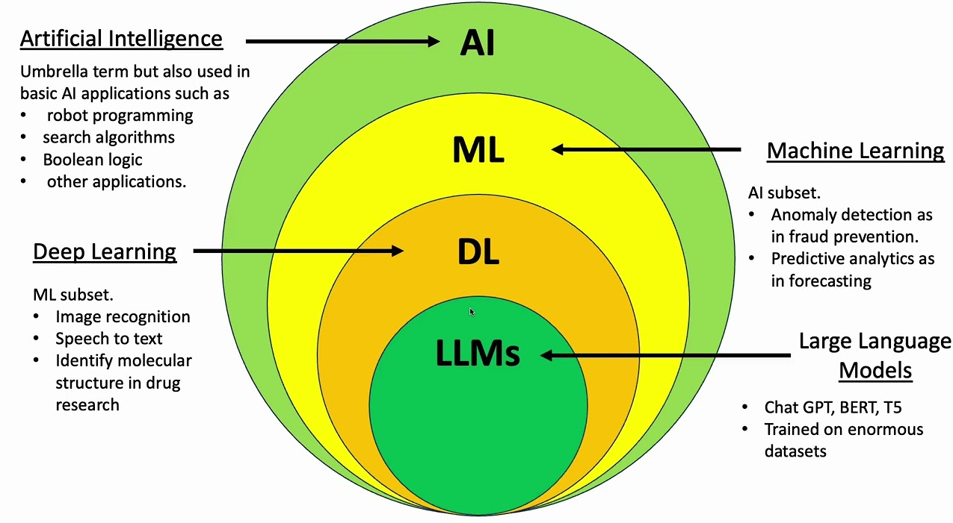
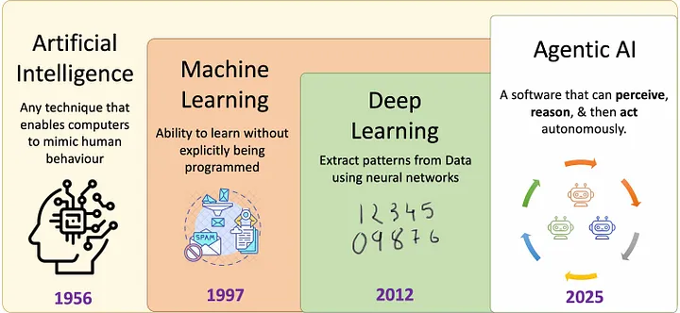
Neural Networks - are structures composed of layers of interconnected nodes (neurons).
where each successive layer extracts progressively more abstract and complex features from the data
Artificial Intelligence - this is a piece of software that can perceive its environment (through APIs,
sensors, or data streams), reason about what it perceives (using AI/ML algorithms or rule-based logic),
and then act autonomously to achieve specific goals.
Machine Learning - models analyze data to learn patterns and make predictions or decisions.
Deep Learning - a specialized subset of neural networks, deep learning utilizes deep neural networks
(DNNs) comprising numerous layers. It excels at processing and learning from large volumes of
unstructured data, including images, audio/video, and text, making it particularly effective for tasks
like image recognition, natural language processing, and voice analysis.
Generative AI - refers to advanced systems capable of producing new content — including text,
images, audio, and even code — based on input data.
Large Language Model - this is a complex mathematical function that predicts what word will come
next for any given piece of text based on statistical data.. .

Slide 2
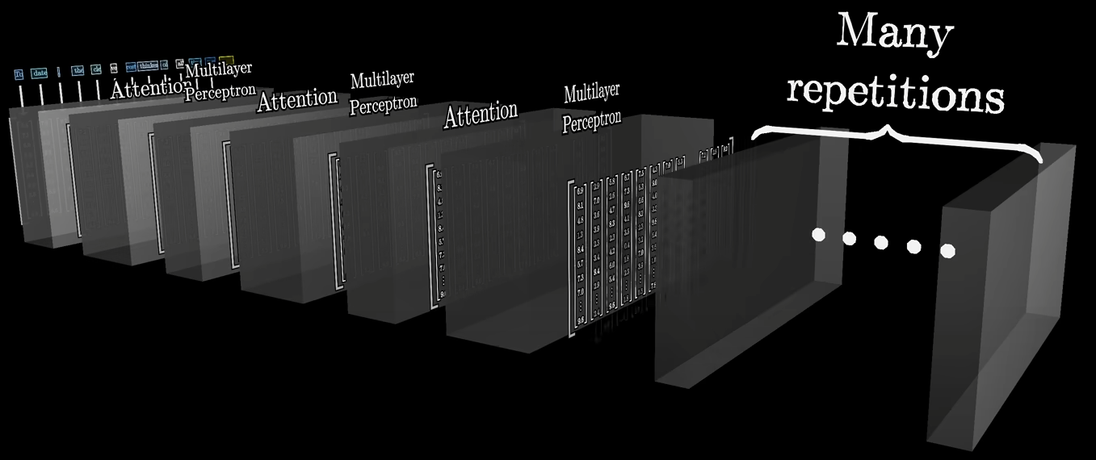
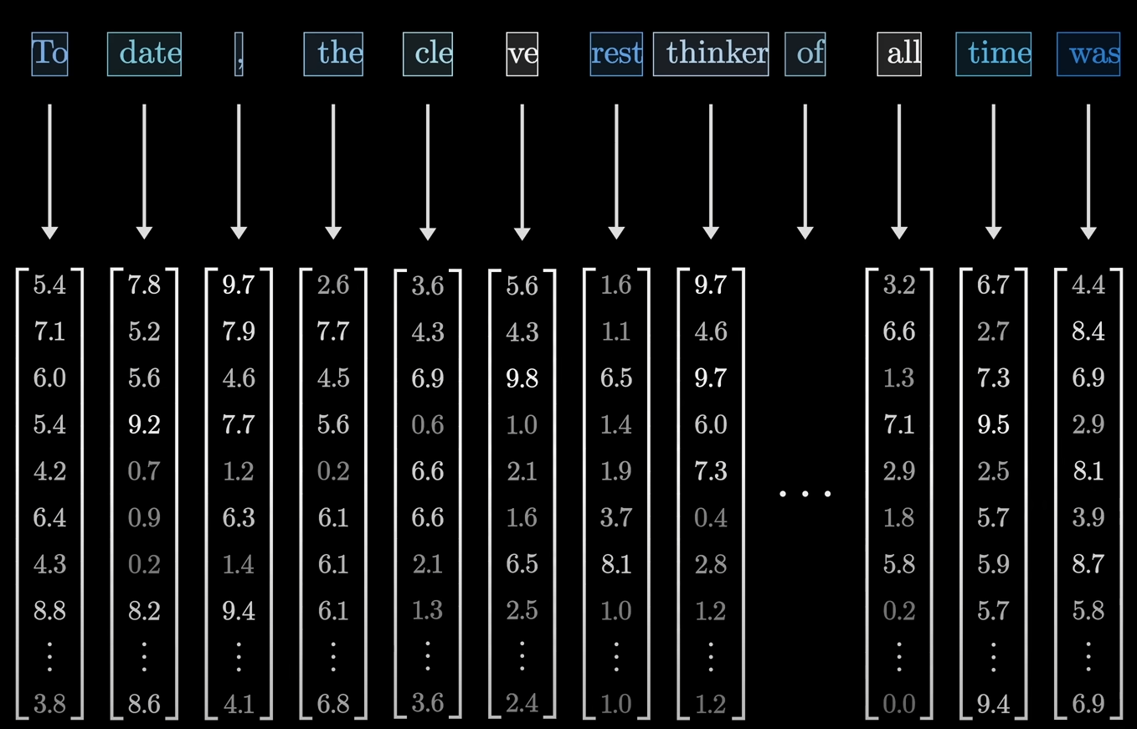
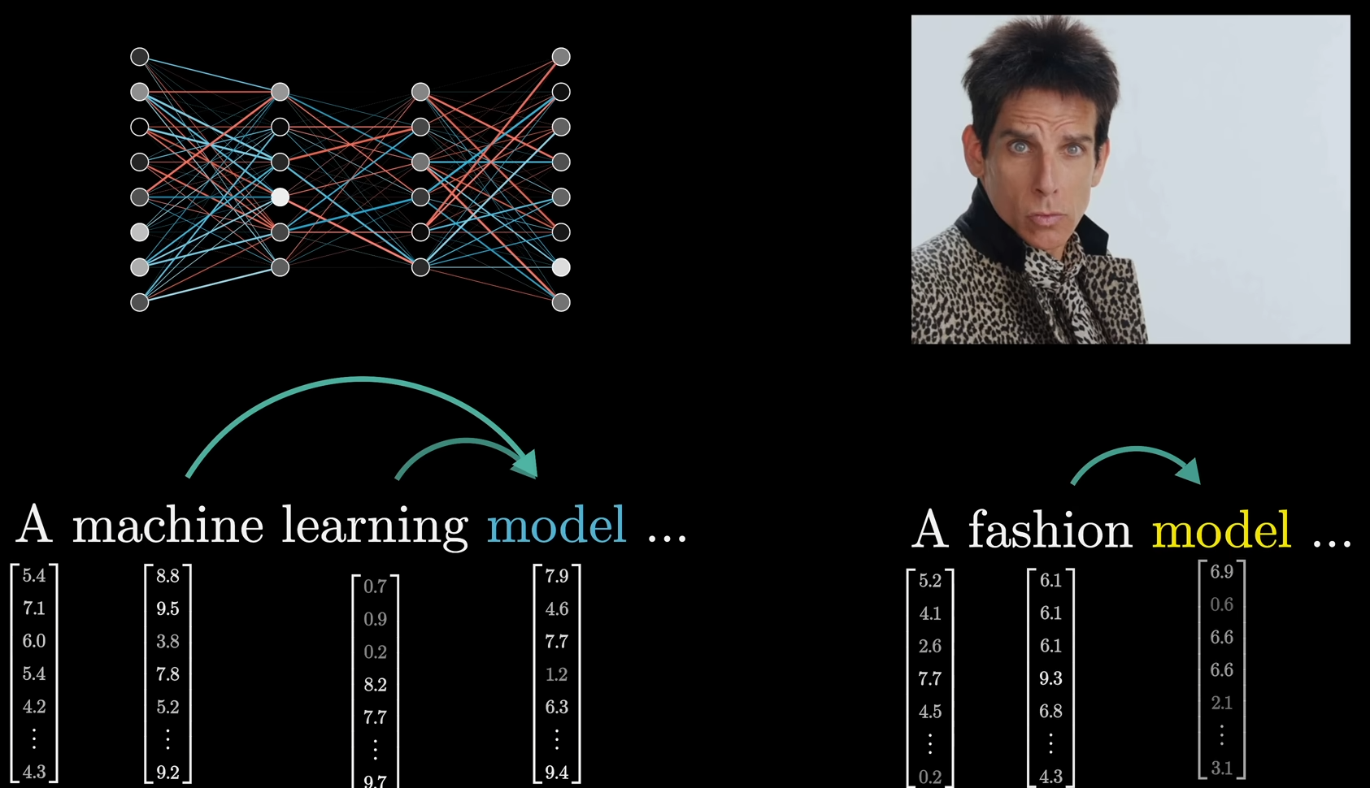
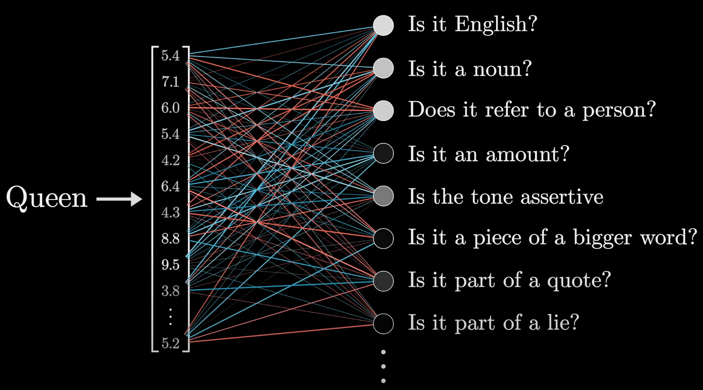
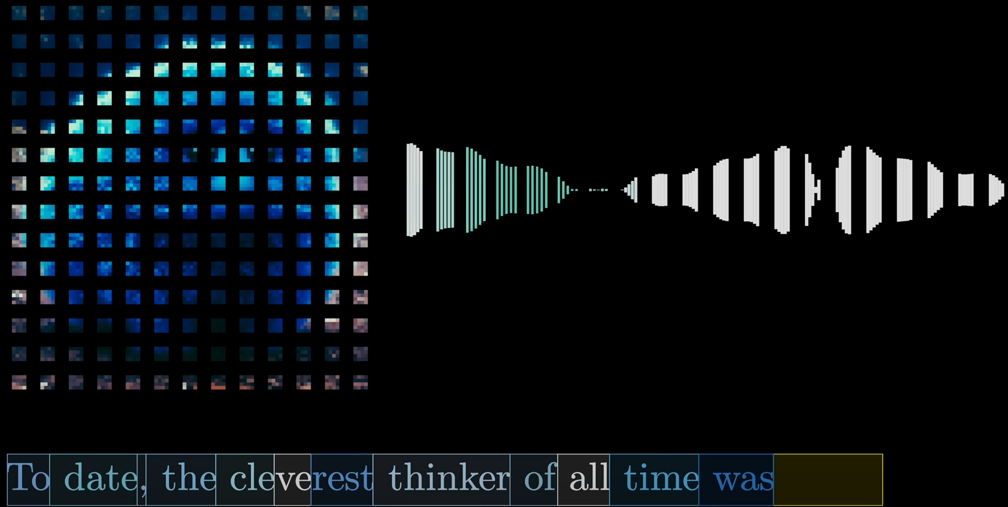
Inside Transformer
Token – is a little pieces of word, symbols or other common character combination,
little patches of an image or little chunks of a sound.
Each of these tokens is then associated with a vector, meaning some list of numbers

Slide 3
